Slide 1
CS 6330 Final Project
User Identification based on Movement
Dan Olson
Rich Lukas
Robert Burkhardt

Slide 2
CS 6330 Final Project
Problem Statement
The Goal of this project was to collect time series data from an IMU, and use it to identify individuals and activities
Movement is highly individualized and unique to each person
Gait is the cyclic movement of the body during locomotion
Gait can be broken down into the Stance phase and Swing phase
Stance Phase Stance Phase
Heel Strike Acceleration Phase
Foot Loading Mid-Swing
Midstance shift Deceleration Phase
Heel-off
Toe-off
Typical methods of analysis consist of stop motion photography, pressure sensors, and accelerometers strapped to the body.

Slide 3
CS 6330 Final Project
Methodology
Data Collection
Three test subjects were outfitted with a 6 axis IMU, which recorded angular velocity and acceleration
Data was collected at 500 hz and then down sampled to 100 hz
The sensor was mounted at the hip
The recorded activities included
Walking at a measured pace
Running
Stair climbing/descending
Treadmill
Sitting
Jumping
Standing

Slide 4
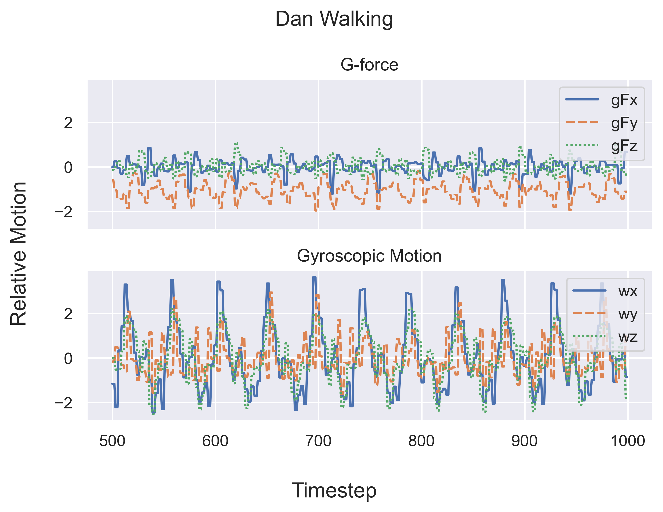
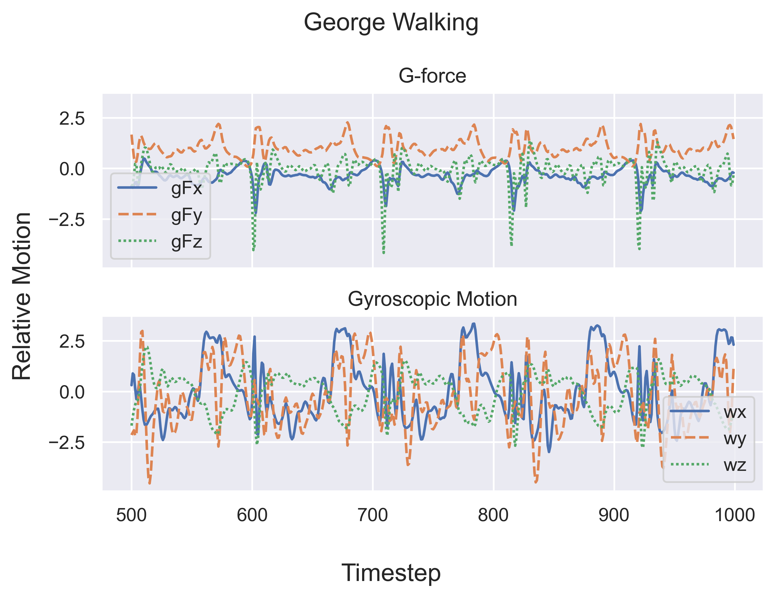
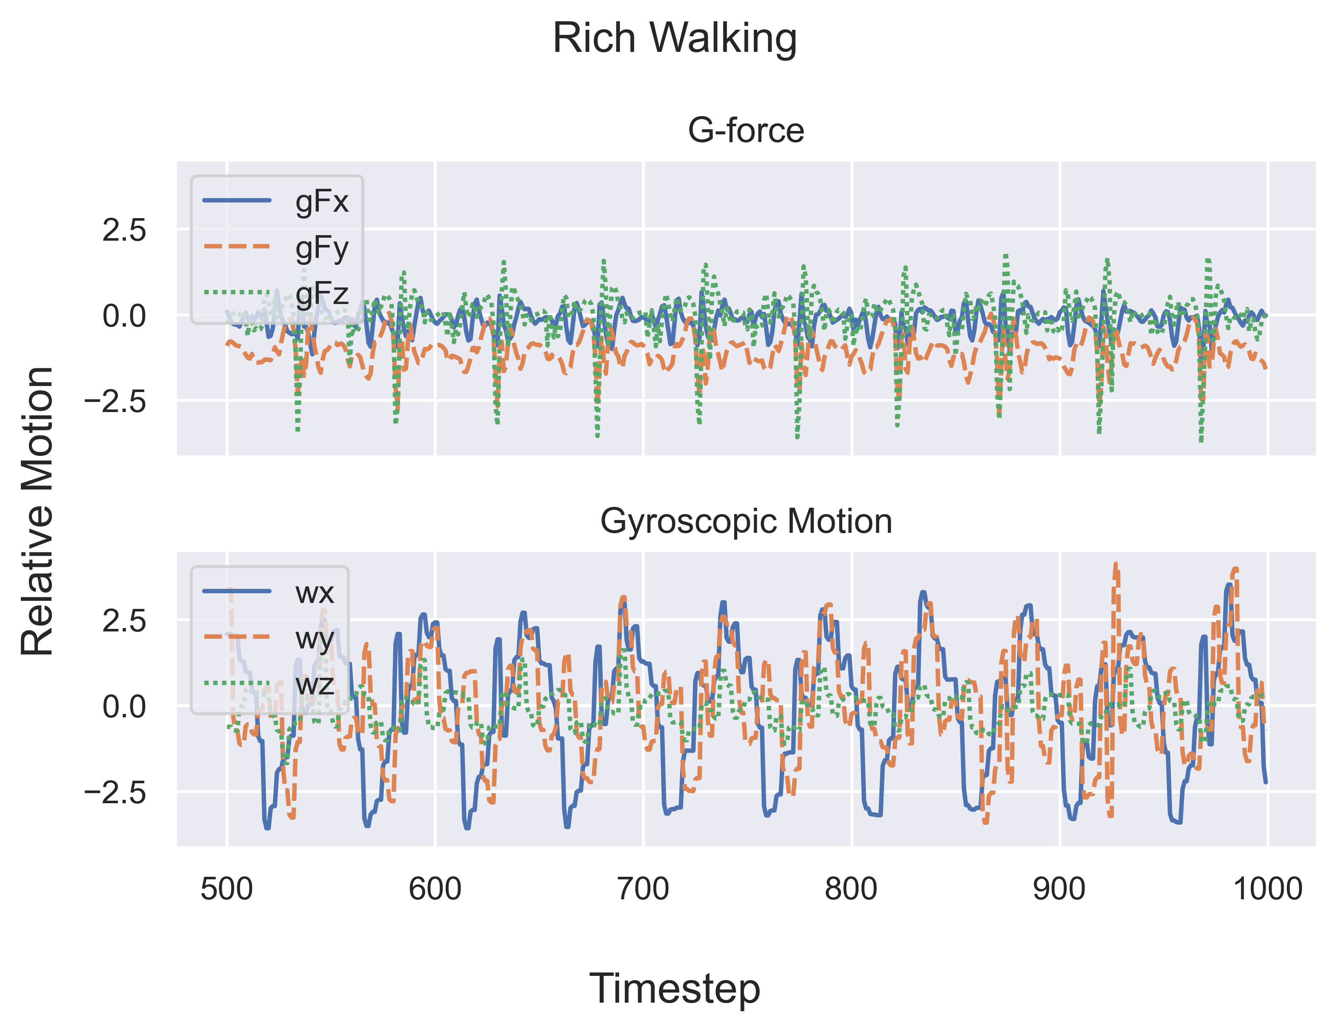
Uniqueness of Gait
Visualization

Slide 5
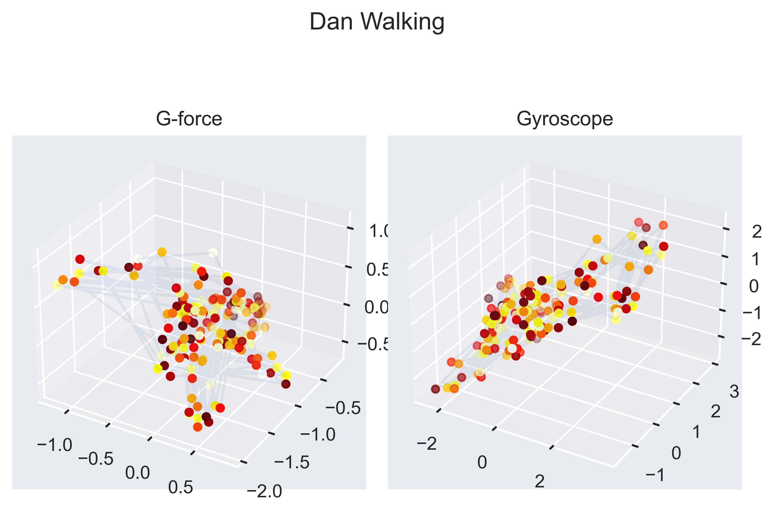
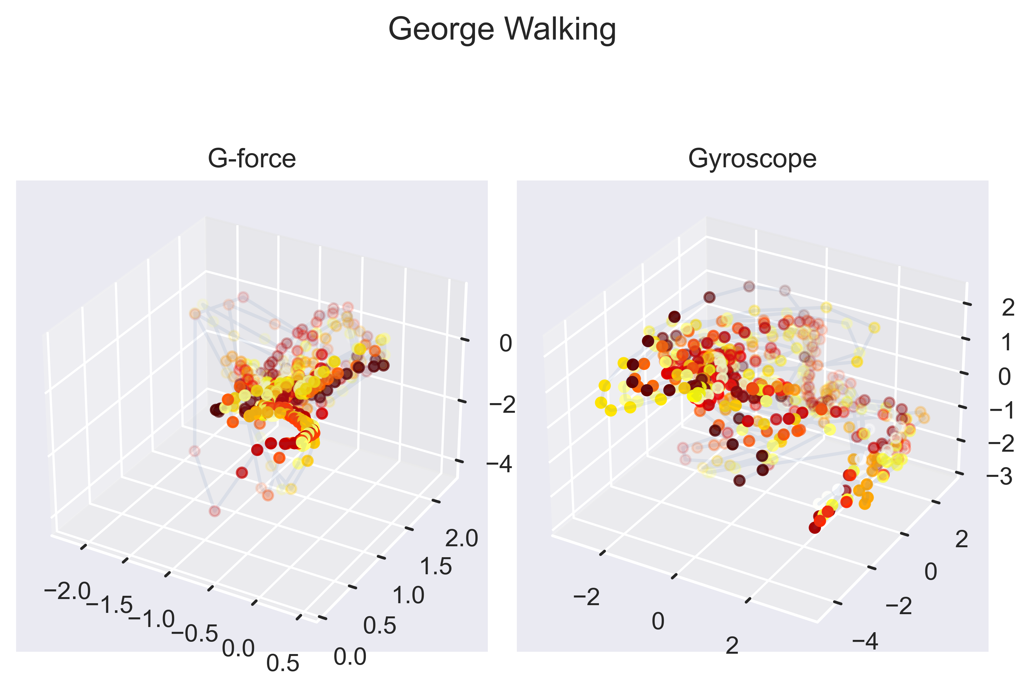
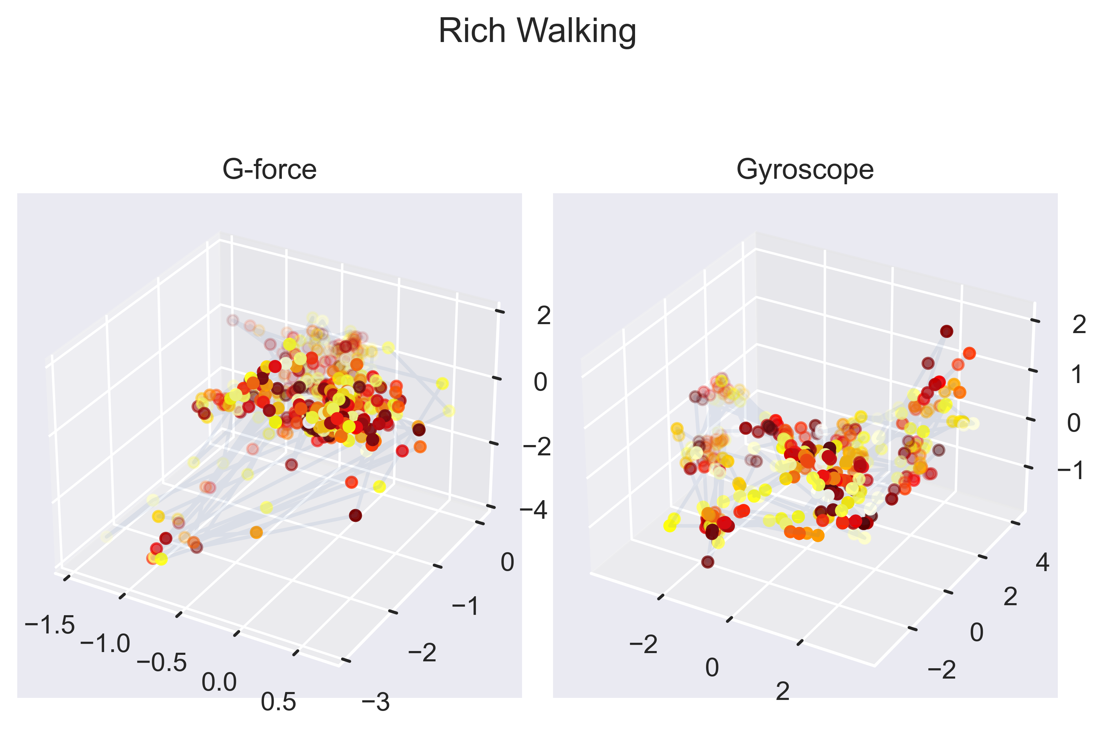
Forces in 3-space
Visualization

Slide 6
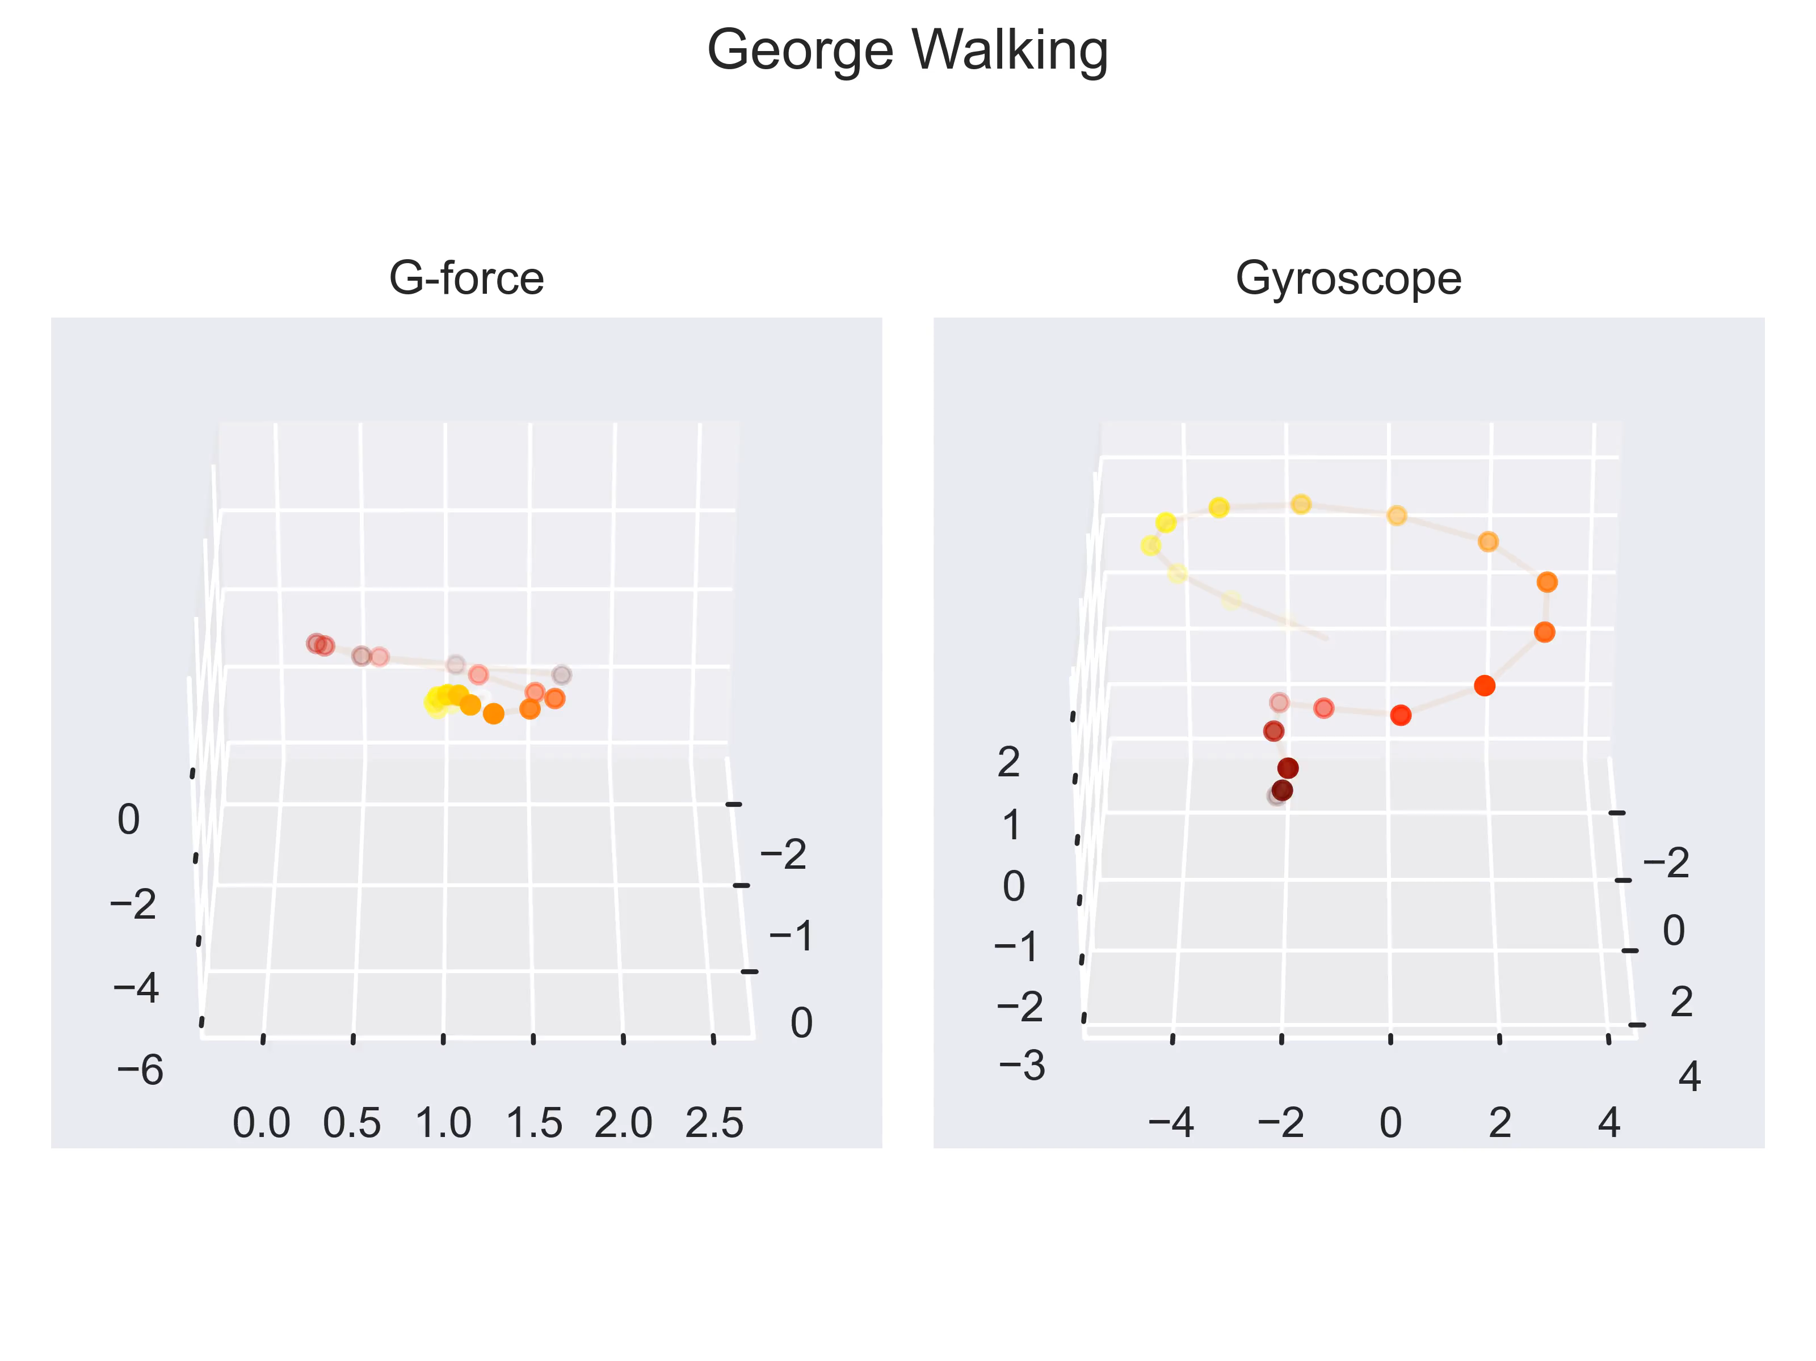
Forces in 3-space
Visualization of Motion

Slide 7
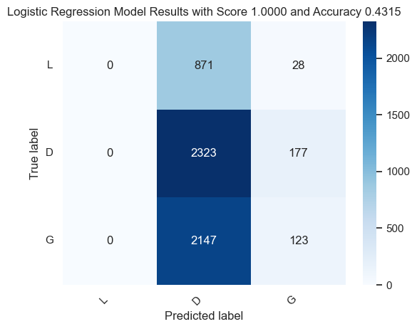
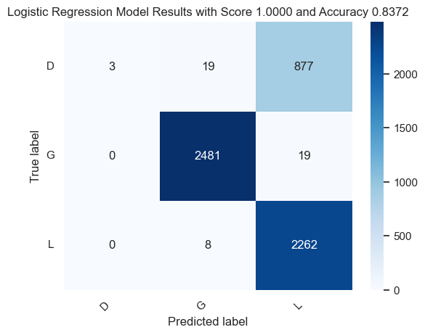
Forces in 3-space
Identify Individuals
Identify Individuals
Our baseline model was a Logistic Regression Classifier. We tested a velocity only and acceleration only version.
Angular Velocity Only
Angular Acceleration Only

Slide 8
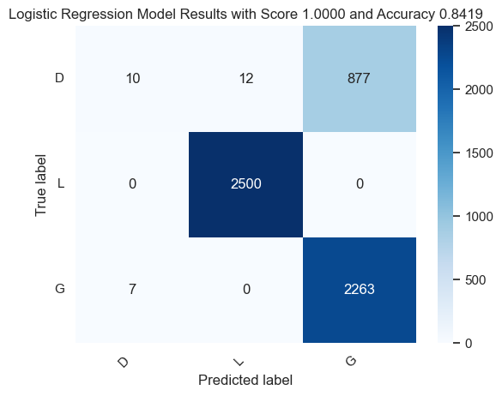
Forces in 3-space
Identify Individuals
Improved Model
We then built a model using both angular velocity and acceleration, and applied
a low pass filter to smooth the data. The results were slightly better.

Slide 9
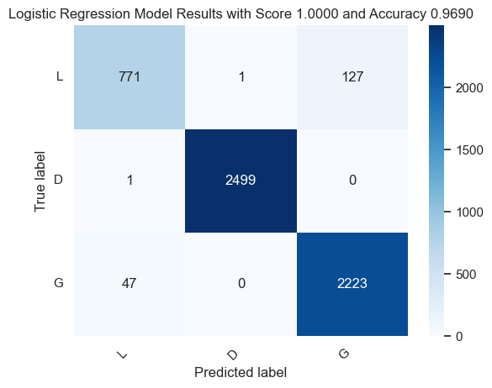
Forces in 3-space
Identify Individuals
Best Logistic Model
After looking at the outliers, we added an additional EWMA filter with a half
Life of 100 ms to add more trend data to the model

Slide 10
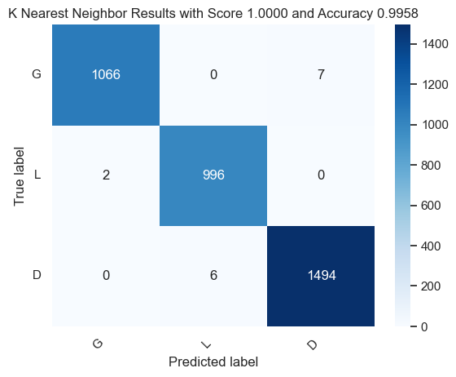
Forces in 3-space
Best Model for User Identification
Explore Other Classifier Types
Multiple Classifier models were tested, including
Logistic Regression Support Vector Machine
Random Forest Decision Tree
K Nearest Neighbors Multi-layer Perceptron Classifier
The KNN model did the best, outperforming all other models. All models were built on stratified Train Test data and compared using a separate Validation dataset.
 | Balanced Accuracy
Logistic Regression | 0.9688
SVM | 0.9437
Random Forest | 0.9703
Decision Tree | 0.9611
KNN | 0.9961
MLP | 0.9818

Slide 11
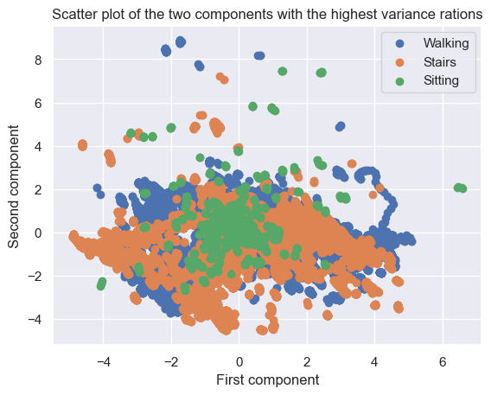
Forces in 3-space
Identify Activity
Identify Activity
Time series data on a variety of activities was collected and labeled. The same feature set as before was used to build classifier models. To help visualize the data a partial correlation analysis was taken to reduce the feature set.
Visually it can be seen
that the data clusters
are heavily overlapped.

Slide 12
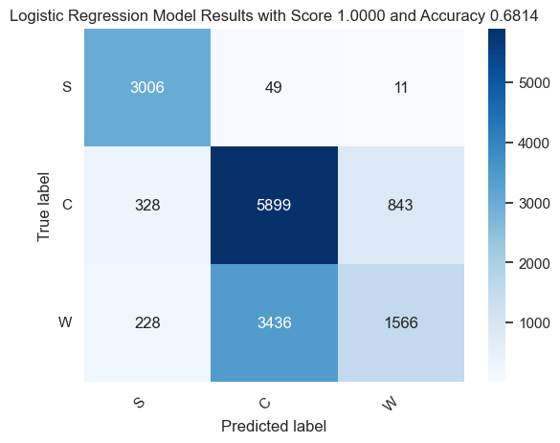
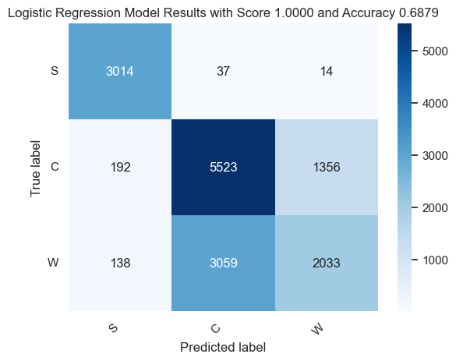
Forces in 3-space
Baseline Activity Detection
Following the same procedure as before, we tested a Logistic regression
Classifier model using angular velocity and acceleration. Adding additional features did not significantly improve the results.
Baseline model using only angular velocity and acceleration
Full Model using all 18 features
S (Sitting) C (Climbing) W (Walking

Slide 13
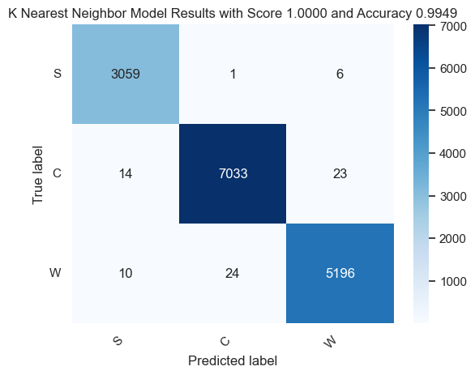
Forces in 3-space
Best Model for Activity Identification
The Logistic Model did not seem promising. To resolve this other models were tested
Multiple Classifier models were developed, including
Logistic Regression Support Vector Machine
Random Forest Decision Tree
K Nearest Neighbors Multi-layer Perceptron Classifier
The KNN model did the best, outperforming all other models. All models were built on stratified
Train Test data, and compared
using a separate Validation
dataset.
 | Balanced Accuracy
Logistic Regression | 0.6857
SVM | 0.6599
Random Forest | 0.9155
Decision Tree | 0.981
KNN | 0.9943
MLP | 0.9128

Slide 14
Forces in 3-space
Reduction
Reduced Feature Set
To reduce the feature set for User Identification, a CART analysis was performed on the Decision Tree Classifier (which had results like the KNN)
The CART analysis shows that the
Exponentially Weighted filtered terms
have the greatest significance. A
similar analysis on Activity Identification
had nearly identical results.
Top Ranked Features
gFyE | Score: 0.638
gFxE | Score: 0.212
wzE | Score: 0.076
gFzE | Score: 0.023
wx | Score: 0.014
wz | Score: 0.011
wyE | Score: 0.007
wy | Score: 0.006
wxm1 | Score: 0.003
gFzm1 | Score: 0.002

Slide 15
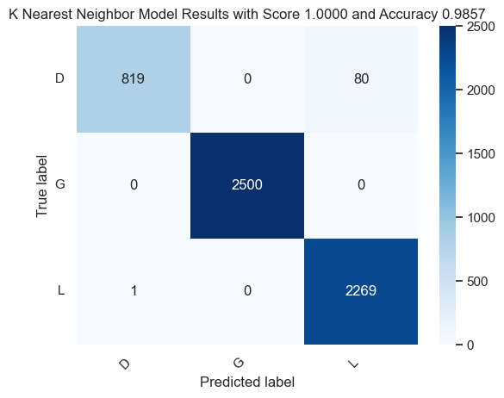
Forces in 3-space
Reduction
Reduced Feature Set
A KNN model for user identification was built using only gFxE, gFyE, gFzE, based on the CART analysis. The results were nearly identical to the full model, showing the model reduction is valid.

Slide 16

Forces in 3-space
Reduction
Reduced Feature Set
A KNN model for Activity identification was built using only exponentially filtered term based on the CART analysis. The results were nearly identical to the full model, showing the model reduction is valid.
Feature Ranking
gFxE | Score: 0.212
gFzE | Score: 0.201
gFyE | Score: 0.168
wxE | Score: 0.08
wyE | Score: 0.044
wzE | Score: 0.04
wxm1 | Score: 0.039
wy | Score: 0.031
gFz | Score: 0.025
wz | Score: 0.023
wzm1 | Score: 0.023
wym1 | Score: 0.023
wx | Score: 0.022
gFy | Score: 0.021
gFx | Score: 0.017
gFxm1 | Score: 0.013

Slide 17
Forces in 3-space
Summary
We met the ask of identifying activity, and identifying individuals based on their gait.
Based on our findings, these explorations could be extended further
Identify Speed/Length of Stride
Abnormal locomotion
Handedness
In principle we can build a power tool that identifies its operator using gait biometrics, rather than a user id. This also suggests that a tool could be customized based on how a user is holding the tool (righty vs lefty etc)
Reasonable model improvements could involve measuring IMU at several points on the body and using stride length as an additional feature.

Slide 18

About Us
Rich Lukas
About Us
Rich Lukas
Mgr EE
ML Team, FEI
Big Takeaways
A great deal of information is buried in IMU data. We can infer a great deal about a work site and user behavior.
Greater confidence in our ability to measure/model our environment beyond simply tool performance
Ability to manipulate data in Python, and create sophisticated analysis

